Slide 1
Linked List
Linear Data Structure
Abstract Data Types
Dynamic Data Structures
Elements are not stored at contiguous memory locations
Series of connected NODES (Node = data + address of next node)
We can keep elements present in a Linked List everywhere in the memory storage where the memory is assigned at run time only, unlike the array where the memory is assigned at the compile time.
Conversely, not like the array, the elements are not present in consecutive memory locations.

Slide 2
Types of Linked List
Singly Linked List
Circular Linked List
Doubly Linked List
Circular Doubly Linked List

Slide 3
Singly Linked List
Collection of nodes linked together in a sequential way where each node of the singly linked list contains a data field and an address field that contains the reference of the next node.
The structure of the node in the Singly Linked List is
You have to start somewhere, so we give the address of the first node a special name called HEAD.
The nodes are connected to each other in the below format where the value of the next variable of the last node is NULL i.e., next = NULL, which indicates the end of the linked list.
class Node {
Object data // variable to store the data of the node
Node next // variable to store the address of the next node
}
next
data
Node
HEAD
10
2459
20
2378
30
NULL
2300
2459
2378

Slide 4
Basic Operations Performed on Linked List
Traversal: To traverse all the nodes one after another.
Insertion: To add a node at the given position.
Deletion: To delete a node.
Searching: To search an element(s) by value.
Updating: To update a node.
Sorting: To arrange nodes in a linked list in a specific order.
Merging: To merge two linked lists into one.

Slide 5
Linked List Node Traversal
To walk through the nodes in the linked list from beginning to end.
Consider, if we may want to print the list or search for a specific node in the list, then we need to traverse the linked list
Algorithm
Step 1: Start with the HEAD node
Step 2: If HEAD is not NULL
Step 2.1: Mark this as currentNode
Step 2.2: Traverse the list until currentNode next is not NULL
Step 3: If HEAD is NULL, the List is EMPTY

Slide 6
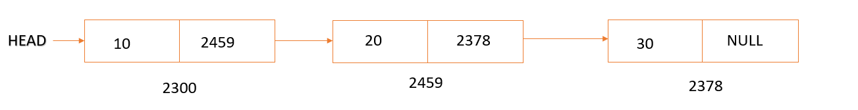
public static void traverse(Node HEAD) {
Node currentNode = NULL;
if(HEAD != NULL){
currentNode = head;
while(currentNode!= NULL) {
print(currentNode.data)// print the value stored in the data of the node
currentNode = currentNode.next //move to the next node in the list
}
}
else{
print(“List is EMPTY”)
}
}

Slide 7
Linked List Node Searching
To search any value in the linked list, we can traverse the linked list and compares the value present in the node.
Algorithm
Step 1: Get the search data
Step 2: If HEAD is NULL, print the List is EMPTY
Step 2: If HEAD is not NULL
Step 2.1: Mark HEAD as currentNode
Step 2.2: Until currentNode next is not NULL
Step 2.2 (a): If currentNode.data is same as given data, print found
Step 2.2 (b): else move to next node
Step 2.3: If currentNode is the last node & given data is not found in the list, print not found

Slide 8
public static void search(int searchValue) {
if(head == NULL) { // check if linked list is empty
print(“List is empty”)
}
else {
Node currentNode = head
while(currentNode!= NULL) {
if(currentNode.data == searchValue){
print(“Found”)
break;
}
currentNode = currentNode.next
}
print(“Not Found”)
}
}

Slide 9
Linked List Node Updating
To update the value of the node, we just need to set the data part to the new value.
Algorithm
Step 1: Get the oldValue and newValue
Step 2: If HEAD is NULL, print the List is EMPTY
Step 2: If HEAD is not NULL
Step 2.1: Mark HEAD as currentNode
Step 2.2: Until currentNode next is not NULL
Step 2.2 (a): If currentNode.data is same as given oldValue, update to the newValue
Step 2.2 (b): else move to next node
Step 2.3: If currentNode is the last node & given oldValue is not found in the list, print oldValue is not found

Slide 10
public static void update(int oldValue,int newValue) {
if(head == NULL) { // check if linked list is empty
print(“List is empty”)
}
else {
Node currentNode = head
while(currentNode!= NULL) {
if(currentNode.data == oldValue){
currentNode.data = newValue
break;
}
currentNode = currentNode.next
}
print(“oldValue is not found in the List”)
}
}

Slide 11
Linked List Node Insertion
We can insert a node to the linked List
At the beginning (as a HEAD node)
At the end (as a last node) (Append a node)
After specific node (given – Address/Data/Position)

Slide 12
Insert At Beginning
If the list is empty, we make the new node as the head of the list.
Otherwise, we have to connect the new node to the current head of the list and make the new node, the head of the list.
Algorithm
Step 1: Create a newNode with data and next as NULL
Step 2: If HEAD is NULL, mark the newNode as HEAD
Step 3: If HEAD is not NULL, assign newNode.next = HEAD and then mark newNode as HEAD
class Node {
Object data // variable to store the data of the node
Node next // variable to store the address of the next node
Node(Object data){
this.data = data
this.next = NULL
}
}

Slide 13
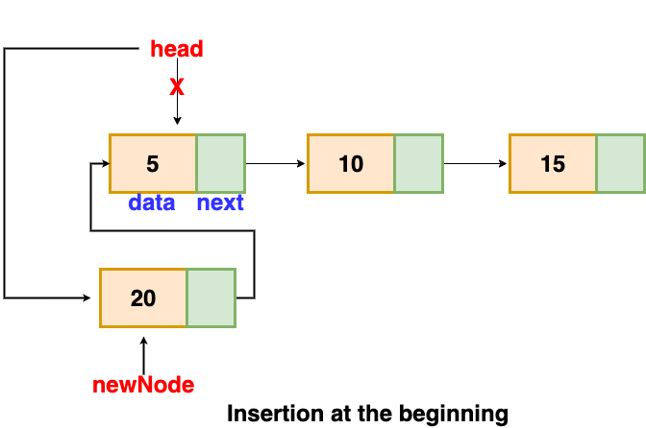
public static void insertAtBegin(int value) {
Node newNode = new Node(value) // creating new node of linked list
if(head == NULL) { // check if linked list is empty
head = newNode
}
else {// inserting the node at the beginning
newNode.next = head
head = newNode
}
}

Slide 14
Insert At End
If the list is empty, we make the new node as the head of the list.
Otherwise, We will traverse the list until we find the last node. Then we insert the new node to the end of the list.
Algorithm
Step 1: Create a newNode with data and next as NULL
Step 2: If HEAD is NULL, mark the newNode as HEAD
Step 3: If HEAD is not NULL
Step 3.1: Assign currentNode = HEAD
Step 3.2: Traverse the list until currentNode next is not NULL
Step 3.3: Assign currentNode.next = newNode

Slide 15
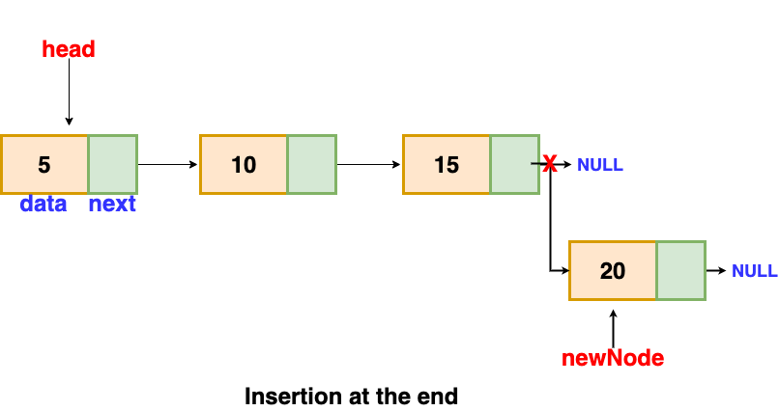
public static void insertAtEnd(int value) {
Node newNode = new Node(value) // creating new node of linked list
if(head == NULL) { // check if linked list is empty
head = newNode
}
else {// inserting the node at the beginning
Node currentNode = head
while(currentNode.next != NULL) {
currentNode = currentNode.next
}
currentNode.next = newNode
}
}

Slide 16
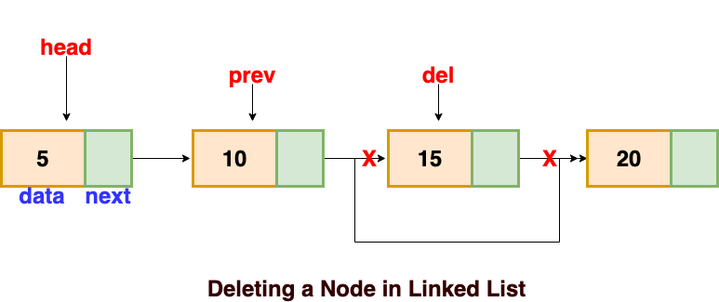
Linked List Node Deletion
We can delete a node to the linked List
From the beginning (the HEAD node)
From the end (the last node)
The specific node (given – Address/Data/Position)

Slide 17
Delete a Node At the given Position
To delete a node, we traverse to that the particular node and remove it from the list.
Previous node is next value needed to updated as deleted node’s next
Algorithm
Step 1: Get the position
Step 2: If HEAD is NULL, print the List is EMPTY
Step 2: If HEAD is not NULL
Step 2.1: Mark HEAD as currentNode and Initialize position = 1
Step 2.2: Traverse the list until currentNode next is not NULL. Increment the position value by 1. Keep track of previous node too.
Step 2.2 (a): If the currentNode position is same as given position. Change the previousNode.next = currentNode.next
Step 2.2 (b): else move to next node
Step 2.3: If currentNode is the last node, given position value is greater the list length, print the position value greater than list length

Slide 18
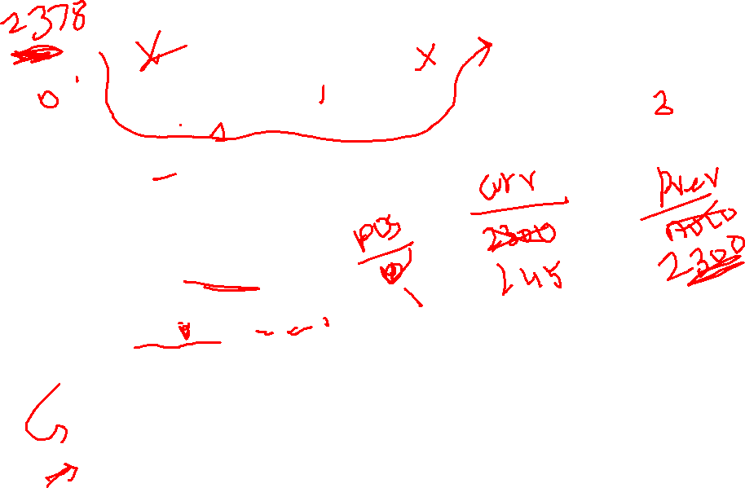
public static void delete(int position) {
int currentPosition = 0;
if(head == NULL) { // check if linked list is empty
print(“List is empty”)
}
else {
Node currentNode = head
Node previousNode = NULL
while(currentNode!= NULL) {
if(currentPosition == position){
previousNode.next = currentNode.next
break
}
previousNode = currentNode
currentNode = currentNode.next
currentPosition++
}
print(“Position is greater than List length”)
}
}

Slide 19
Few applications of Singly Linked List
It is used to implement stacks and queues which are like fundamental needs throughout computer science.
To prevent the collision between the data in the hash map, we use a singly linked list.
If we ever noticed the functioning of a casual notepad, it also uses a singly linked list to perform undo or redo or deleting functions.
We can think of its use in a photo viewer for having look at photos continuously in a slide show.

Slide 20
Doubly Linked List
Each node stores the address of the previous and next node.
The structure of the node in the Doubly Linked List
You have to start somewhere, so we give the address of the first node a special name called HEAD.
The nodes are connected to each other in the below format where
the value of the next variable of the last node is NULL i.e., next = NULL, which indicates the end of the linked list.
the value of the previous variable of the first node is NULL i.e., prev = NULL, which indicates the first of the linked list
prev next
class Node {
Object data // variable to store the data of the node
Node next // variable to store the address of the next node
Node prev // variable to store the address of the previous node
}
data
Node
HEAD
NULL
10
2459
2300
20
2378
2459
30
NULL
2300
2459
2378

Slide 21
Circular Linked List
Same as Singly Linked List, but the last node points to the first head node forming a circle.
The structure of the node in the Circular Linked List is (same as Singly Linked List)
You have to start somewhere, so we give the address of the first node a special name called HEAD.
The nodes are connected to each other in the below format where the value of the next variable of the last node points the first node (HEAD node) i.e. lastNode.next = HEAD
next
class Node {
Object data // variable to store the data of the node
Node next // variable to store the address of the next node
}
data
Node
HEAD
10
2459
20
2378
30
2300
2300
2459
2378

Slide 22
Circular Doubly Linked List
Same as Doubly Linked List, but the last node points to the first head node forming a circle.
The structure of the node in the Circular Doubly Linked List (same as Singly Linked List)
You have to start somewhere, so we give the address of the first node a special name called HEAD.
The nodes are connected to each other in the below format where
the value of the next variable of the last node points the first node (HEAD node)
the value of the previous variable of the first node points the last node
prev next
class Node {
Object data // variable to store the data of the node
Node next // variable to store the address of the next node
Node prev // variable to store the address of the previous node
}
data
Node
HEAD
2378
10
2459
2300
20
2378
2459
30
2300
2300
2459
2378

Slide 23
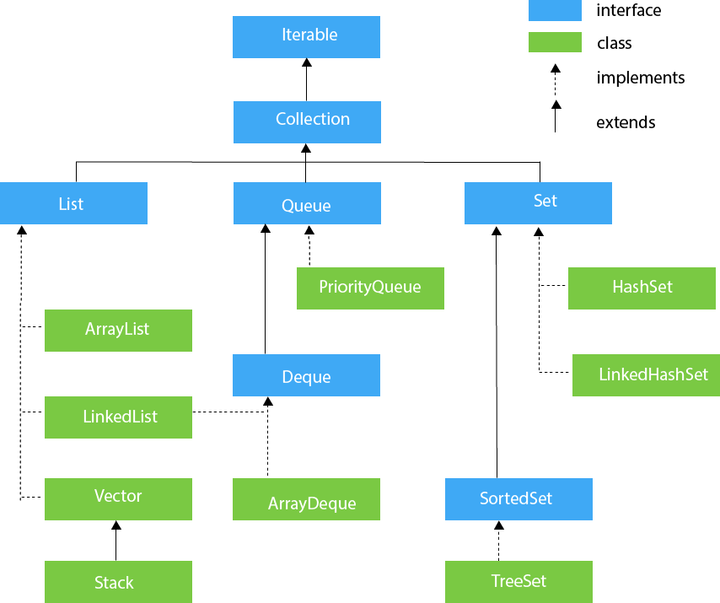
LinkedList in Collection API

Slide 24
LinkedList Methods | Method Description | Example
new LinkedList() | Create a LinkedList | LinkedList<Integer> LL = new LinkedList<Integer>();
boolean add(E e) | Adds an element to the Linked List | LL.add(13); LL.add(23);
void add(int index, E e) | insert the specified element at the specified position index in a list. | LL.add(1, 34);
void addFirst(E e) | It is used to insert the given element at the beginning of a list. | LL.addFirst(25);
void addLast(E e) | It is used to append the given element to the end of a list. | LL.addLast(45);
boolean offer(E e) | It adds the specified element as the last element of a list. | LL.offer(78);
boolean offerFirst(E e) | It inserts the specified element at the front of a list. | LL.offerFirst(67);
boolean offerLast(E e) | It inserts the specified element at the end of a list. | LL.offerLast(56);

Slide 25
LinkedList Methods | Method Description | Example
E element() | It is used to retrieve the first element of a list. | LL.element()
E get(int index) | It is used to return the element at the specified position in a list. | LL.get(3)
E getFirst() | It is used to return the first element in a list. | LL.getFirst()
E getLast() | It is used to return the last element in a list. | LL.getLast()
boolean contains(Object o) | It is used to return true if a list contains a specified element.
int indexOf(Object o) | It is used to return the index in a list of the first occurrence of the specified element, or -1 if the list does not contain any element.
int lastIndexOf(Object o) | It is used to return the index in a list of the last occurrence of the specified element, or -1 if the list does not contain any element.
Object clone() | It is used to return a shallow copy of an ArrayList.
E set(int index, E element) | It replaces the element at the specified position in a list with the specified element.
int size() | It is used to return the number of elements in a list.

Slide 26
LinkedList Methods | Method Description | Example
E remove() | It is used to retrieve and removes the first element of a list.
E remove(int index) | It is used to remove the element at the specified position in a list.
boolean remove(Object o) | It is used to remove the first occurrence of the specified element in a list.
E removeFirst() | It removes and returns the first element from a list.
boolean removeFirstOccurrence(Object o) | It is used to remove the first occurrence of the specified element in a list (when traversing the list from head to tail).
E removeLast() | It removes and returns the last element from a list.
boolean removeLastOccurrence(Object o) | It removes the last occurrence of the specified element in a list (when traversing the list from head to tail).
void clear() | It is used to remove all the elements from a list.

Slide 27
LinkedList Methods | Method Description | Example
E peek() | It retrieves the first element of a list
E peekFirst() | It retrieves the first element of a list or returns null if a list is empty.
E peekLast() | It retrieves the last element of a list or returns null if a list is empty.
E poll() | It retrieves and removes the first element of a list.
E pollFirst() | It retrieves and removes the first element of a list, or returns null if a list is empty.
E pollLast() | It retrieves and removes the last element of a list, or returns null if a list is empty.
E pop() | It pops an element from the stack represented by a list.
void push(E e) | It pushes an element onto the stack represented by a list.

Slide 28
LinkedList VS ArrayList
ArrayList internally uses a dynamic array to store its elements. LinkedList uses Doubly Linked List to store its elements.
ArrayList is slow as array manipulation is slower. LinkedList is faster being node based as not much bit shifting required.
ArrayList implements only List. LinkedList implements List as well as Queue. It can act as a queue/stacks as well.
ArrayList is faster in storing and accessing data. LinkedList is faster in manipulation of data.

Slide 29
Some of the main advantages or benefits that the linked list delivers:
Dynamic Type Data Structure:
A linked list is capable of developing and shrinking at the runtime due to the dynamic organization performed by assigning and not assigning memory.
Thus, it is not required to provide the linked list with primary size.
No Wastage of Memory
The Linked List offers achievement of effective memory utilization because the size of this list rise or fall at runtime; hence there is no wastage of memory.
Also, there is no requirement for pre-assigning the memory.
Implementation
The Linear type data structures such as queues and stack are simply executed often by means of a Linked list.
Insert and Delete Operations:
In this linked List, it is easy to perform the insertion and deletion query operations.
We do not require to move elements after the operations of inert and delete of an element, but just the address available in the succeeding pointer requires to be modified.

